Slide 1

BASIC ELECTRONICS AND ELECTRICAL ENGINEERING
BY- CHANDANA MN (CSE-087)
HARSHITHA MASUR(AE-016)
PRIYANKA HANSDA(AE-009)
ASSIGNED BY- DR.HARINATH AIREDDY

Slide 2
HOME ELECTRICAL TRAINING SYSTEM

Slide 3
HOME ELECTRICAL TRAINING SYSTEM
FLUORESCENT LAMP WIRING
STAIRCASE WIRING
CONNECTION OF FAN WITH REGULATOR

Slide 4
Introduction:
A House Electrical Wiring Training System is one of the versatile electrical product provides complete fundamental details of components used in house wiring.
It gives us a complete description and demonstration of wiring basic electrical components, protective devices and house appliance.
We get an opportunity to enhance our electrical skills in an easy manner.
The electricaltraining system consist of Single-Phase Energy Meter, MCB, controlling switches, tube light with choke, two-way switch, ceiling fan connecting terminals with regulator, fault protection section, load points, ground points. Good quality, reliable sockets are provided at appropriate places on board for electric board supply and load connections.

Slide 5
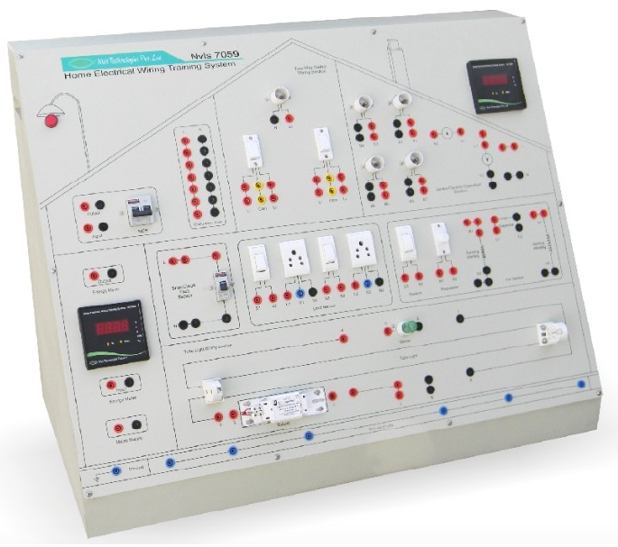

Slide 6
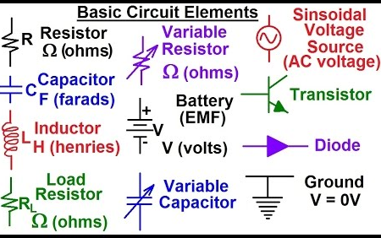
Elements and their circuit symbols

Slide 7
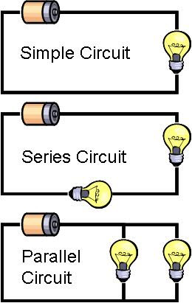
Basic circuit connections

Slide 8
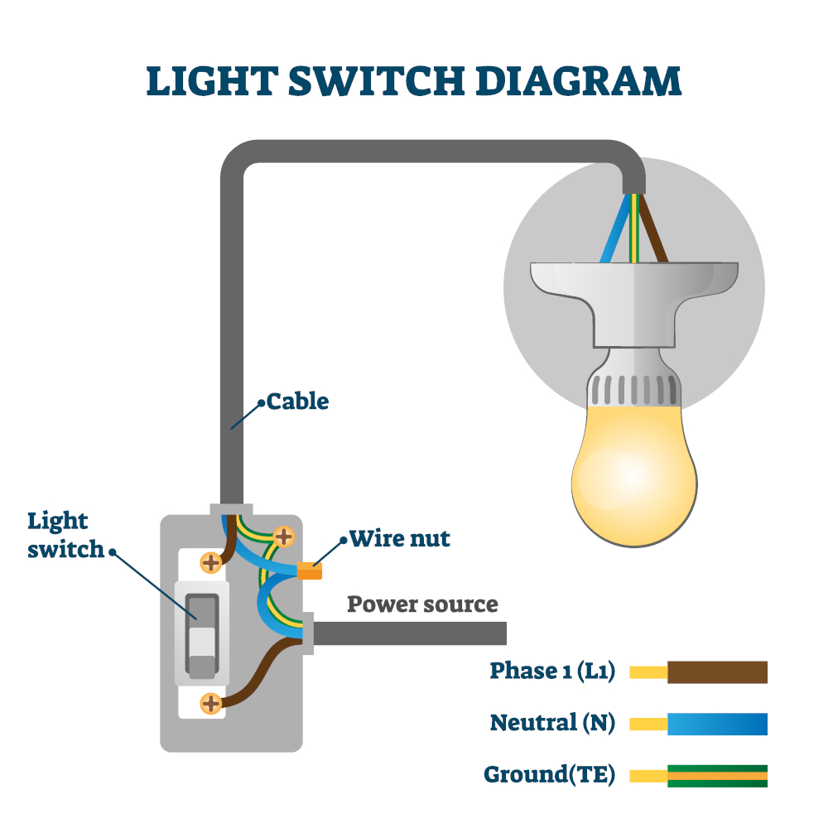
Types of wires
Phase wire
Neutral wire
Ground wire

Slide 9
Now let us go to the experiment

Slide 10
1.FLUORESCENT LAMP WIRING

Slide 11
Aim:
To study & verify the connection procedure for Tube Light wiring section.

Slide 12
Materials required:
Sl no | Name of the apparatus | Range/Type | Quantity
1 | Fluorescent lamp fixture | 2 ft | 1
2 | Fluorescent lamp | 20W | 1
3 | Choke | 230V, 20W | 1
4 | Starter | - | 1
5 | Patch Cards | - | As per requirement

Slide 13
Theory:
Tube Light: A fluorescent tube is a gas-discharge lamp that uses electricity to excite mercury vapor. The excited mercury atoms produce short-wave ultraviolet light that then causes a phosphor to fluoresce, producing visible light. A fluorescent lamp converts electrical power into useful light more efficiently than an incandescent lamp. The lamp is more costly because it requires a ballast to regulate the flow of current through the lamp.

Slide 14
BALLAST (CHOKE):Choke is the inductor coil/ballast which is used to induce high voltage across it. Then gas inside the starter gets ionized due to this full voltage and heats the bimetallic strip that is caused to be bent to connect to the fixed contact. This increases the cost of fluorescent light, though often one ballast is shared between two or more lamps.
Starter: The starter is a circuit which breaks at regular intervals. When you break a circuit and start again, high voltage spark takes place. This voltage is further amplified through the choke which is transformer. Thus, at the beginning the starter gives high voltage sparks. Due to this the current begins to flow through the tube and the tube begins to glow. Once the tube starts, the required voltage to sustain is quite low, which is provided by the choke.

Slide 15
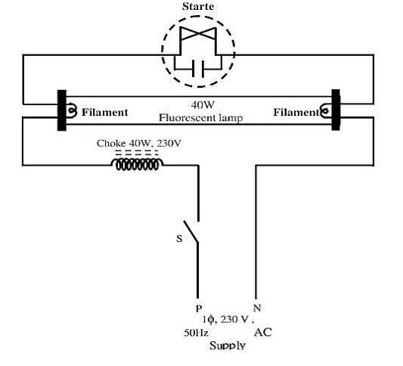
Circuit Diagram:

Slide 16
Procedure:
1. First connect the tube light on tube light connectors and starter in starter holder provided on the panel.
1
2. Connect terminal 1 of Ballast to terminal L of Tube Light section and terminal 2 to terminal 3 of Tube Light.
2
3. Connect terminal 4 to terminal 5 and terminal 6 to terminal 7.
3
4. Connect terminal 8 to terminal N of Tube Light section.
4
5. Now connect L and N terminals of Tube Light section to L and N terminals of CU as shown in figure.
5
6. Now switch On the MCB, so tube light will turn on.
6

Slide 17
Precautions:
1. While giving the connection be careful.
2. Handle the lamp safely.
3. Be careful while handling the tools.
4. All the connections should be right and tight.

Slide 18
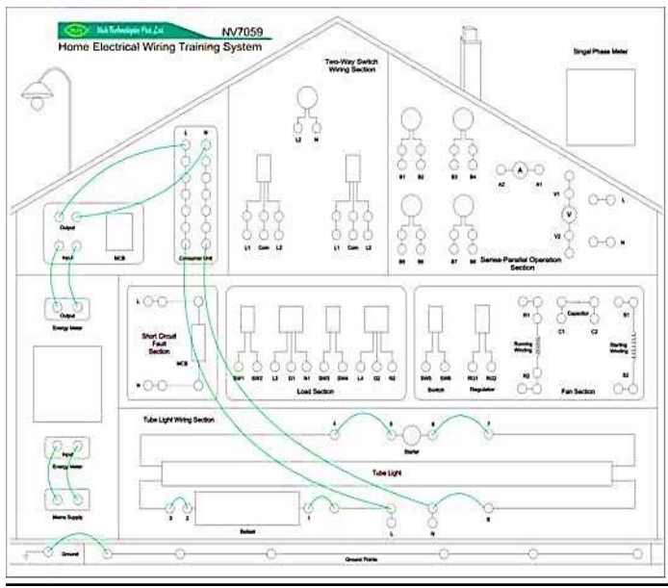
Connection Diagram for Fluorescent lamp wiring

Slide 19
Result:
The connection procedure for tube light wiring section is studied and verified.

Slide 20
STAIRCASE WIRING

Slide 21
Aim:
To study & verify the connection procedure for Two-Way Switch wiring section.

Slide 22
Materials required:
Sl.no | Name of the apparatus | Range/Type | Quantity
1 | Incandescent Lamp | 100W | 1
2 | Lamp Holder | Pendent Type | 1
3 | SPDT Switch | 230V, 5A | 1
4 | Patch Cards | - | As per requirement

Slide 23
Theory:
Switch is an electrical component that can break an electrical circuit, interrupting the current or diverting it from one conductor to another. The most familiar form of switch is a manually operated electromechanical device with one or more sets of electrical contacts. Each set of contacts can be in one of two states: either 'ON' meaning the contacts are touching and electricity can flow between them, or 'OFF', meaning the contacts are separated and no conducting.
Two-Way Light Switch a two-way switch refers to a pair of switches that control the same circuit. In a two-way switch, electricity can flow if both switches are turned to the "up" position or both switches are turned to the down position. If one switch is up and the other is down, however, the circuit will not light. This system is very useful in homes, particularly on stairs. You can turn on the light at the bottom to walk-up the stairs in the evening, then turn the light back off again at the top. Two-Way Light Switch Wiring is used to light up the stairs of a building is connected to the two switches that control it from either end. These two-way switches have a single pole double throw (SPDT) configuration. Each has a common terminal (COM) with a pole that can be switched between position L1 or L2.

Slide 24
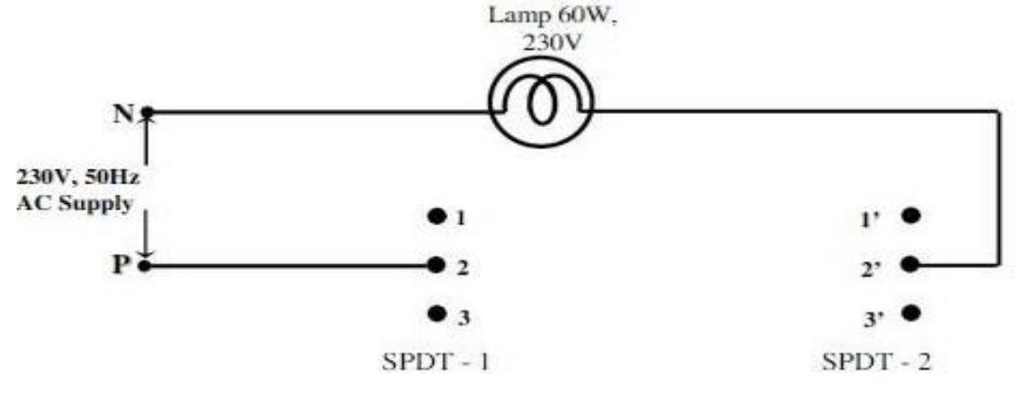
Circuit Diagram:

Slide 25
Procedure:
1. First connect bulb in bulb holder of Two-Way Switch wiring section.
1
2. Connect terminals L1, Com and L2 of SW1 to terminals L1, Com and L2of SW2 respectively as shown in figure.
2
3. Connect terminal L2 of switch 2 to terminal L2 of bulb.
3
4. Connect L and N terminals of CU to terminal L1 of switch 1 and terminal N of bulb respectively.
4
5. Now switch On the MCB.
5
6. With this configuration, the lamp will be turned ON when one switch is at ON position and the other is at OFF position. If both switches are in the same position, the lamp will be OFF.
6

Slide 26
Position Table:
Sl.no | SW-1 | SW-2 | RESULT( LAMP STATUS) ON/OFF
1 | ON | OFF
2 | OFF | ON
3 | ON | ON
4 | OFF | OFF

Slide 27
Precautions:
1. While giving the connection be careful.
2. Handle the lamp safely.
3. Be careful while handling the tools.
4. All the connections should be right and tight.

Slide 28
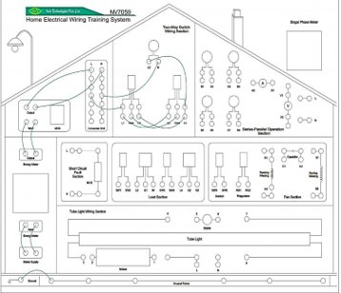
Connection Diagram for Staircase wiring:

Slide 29
Result:
The study & verification of Two-Way Switch wiring section is studied.

Slide 30
CONNECTION OF FAN WITH REGULATOR

Slide 31
Aim:
To study the connection of Fan with switch and regulator.

Slide 32
Materials required:
Sl.no | Name Of The Apparatus | Range/Type | Quantity
1 | Ceiling Fan | single phase capacitor start type induction motor | 1
2 | Regulator | - | 1
3 | Switch | 230V,5A | 1
4 | Patch Cards | - | As per the Requirement

Slide 33
Theory:
Ceiling Fan: A ceiling fan is a device suspended from the ceiling of a room, which employs hub mounted rotating paddles to circulate air. Unlike air conditioners, fans only move air they do not directly change its temperature. Therefore, ceiling fans that have a mechanism for reversing the direction in which the blades rotate and can help in both heating and cooling. A ceiling fan, with its direction of rotation set so that air is drawn upward, pulls up the colder air below, forcing the warmer air nearer the ceiling to move down to take its place, without blowing stream of air directly at the occupants of the room. This action works to even out the temperature in the room, making it cooler nearer the ceiling, but warmer nearer the floor. Thus, the thermostat in the area can be set a few degrees lower to save energy, while maintaining the same level of comfort.
The ceiling fan has single phase capacitor start type induction motor. Single phase induction motor need starting torque, for that purpose capacitor is used to make phase shift b/w running and starting winding and to provide high starting torque.

Slide 34
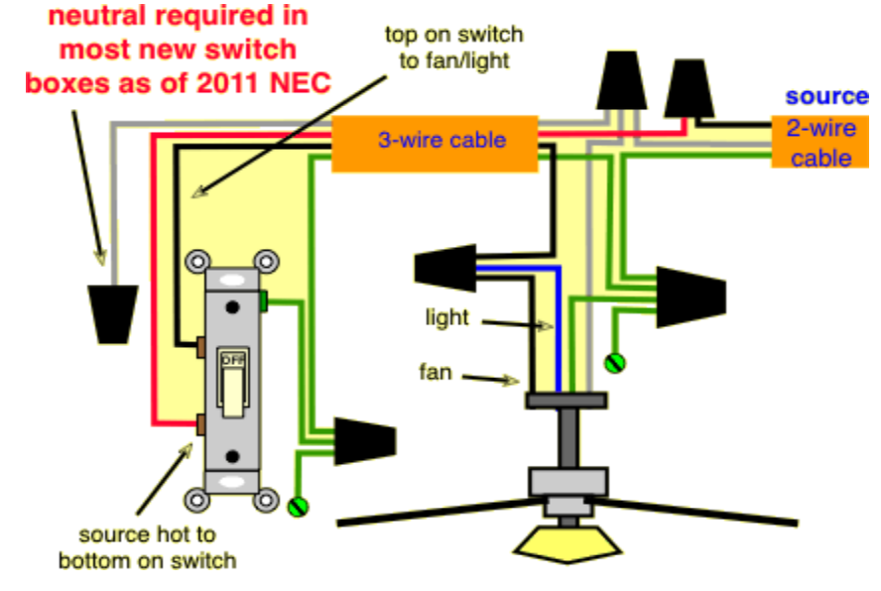
Circuit Diagram:

Slide 35
Procedure:
1. Make sure that switch and regulator of Fan section and main MCB is at Off position.
2. Connect Running Winding terminals of fan to terminals R1 and R2 of Fan Section provided on panel.
3. Connect Starting Winding terminals of fan to terminals S1 and S2 provided on panel.
4. Connect Capacitor terminals of fan to terminals C1 and C2 provided on panel.
5. Connect terminal SW6 to terminal RG1 of regulator & terminal RG2 to terminal R1 of Running Winding.
6. Connect terminal R1 to terminal C1 and terminal C2 to terminal S1.
7. Connect terminal S2 to terminal R2 of Running Winding.
8. Connect L and N terminals of CU to terminals SW5 and R2 Running Winding respectively as shown in figure 15.
9. Now switch On the MCB.
10. Now switch On the switch of fan section and slowly increase regulator to increase speed of fan, when regulator is at its maximum position fan moves at its higher speed. So we can control the speed of fan through regulator.

Slide 36
Precautions:
1. While giving the connection be careful.
2. Handle the Fan safely.
3. Be careful while handling the tools.
4. All the connections should be right and tight.

Slide 37
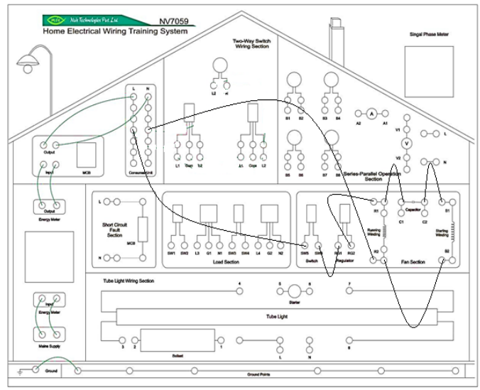
Connection Diagram for Ceiling fan

Slide 38
Result:
The connection of Fan with switch and regulator is studied and verified.

Slide 39


Slide 40


